Slide 1
PY620-Class 4
Inferential stats.
Samples and Populations
Sample statistics and Population parameters.
Hypothesis testing.
Standard deviation and standard error.
Z-test
Rationale behind significance testing.
Signal to Noise.
Errors, errors, and more errors.
Type I error.
Type II error.
Power.
Effect Size.
Confidence Intervals.

Slide 2
It’s all Greek to me: What those funny letters mean.
Greek | Name | Roman | Stats
α | Alpha | a | Type I error
β | Beta | b | Type II error
μ | Mu | M | mean
σ | Sigma | s | Standard deviation

Slide 3
Standard Error of the Mean
A standard deviation is a measure of the dispersion (spread) of individual values around a sample mean.
What if we want to know what the dispersion (spread) of sample means were around a population mean?
If we took an infinite number of samples from a population, there would be a normal distribution of those sample means around the population mean.

Slide 4
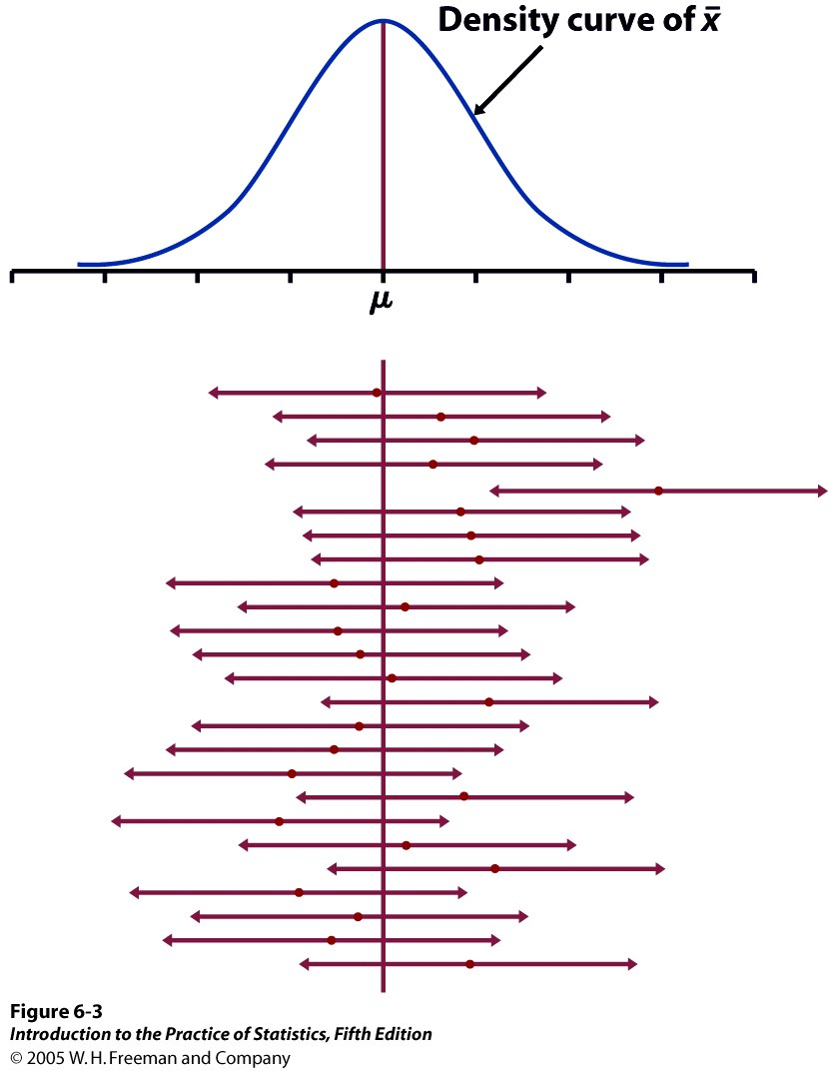


95% of all sample means will be within roughly 2 standard deviations (2*σ/√n) of the population parameter μ.
Because distances are symmetrical, this implies that the population parameter μ must be within roughly 2 standard deviations from the sample average , in 95% of all samples.
Red dot: mean value
of individual sample
This reasoning is the essence of statistical inference.

Slide 5
Standard Error of the Mean and Standard Deviation
The Standard Deviation (SD) reflects how close individual scores cluster around their mean, whereas the Standard Error of the Mean (SE) shows how close mean scores from repeated samples will be to the true (population) mean.

Slide 6
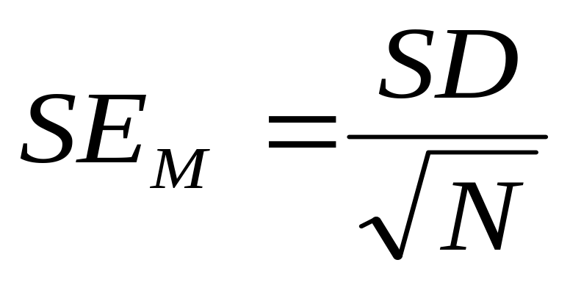
Standard Error of the Mean (SE_{M}): Formula
The SE is related directly to the sample mean and the sample size.

Slide 7
Standard Error of the Mean: an example
What if we know that the sleep time for our class was 7.19 hours and that the SD of that mean is .973. What if we were interested in the mean hours of sleep for St. Mary University students (our population of interest).
We can work from our sample standard deviation and estimate the SE for the population it came from.

Slide 8
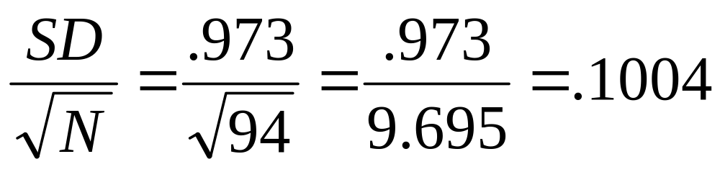
Standard Error of the Mean: an example
The Standard Unit of dispersion of sample means (Standard Error) around the population mean is .1004 hours.

Slide 9
Now we have the SE, why did we bother?
So we have the Standard Error- big deal! What's it good for?
The SE lets us compare our mean to the population mean.
Suppose that the "true" mean hours of sleep of the St. Mary's University students was 7.5. How would our class sleep time compare to the St. Mary's population sleep time?

Slide 10
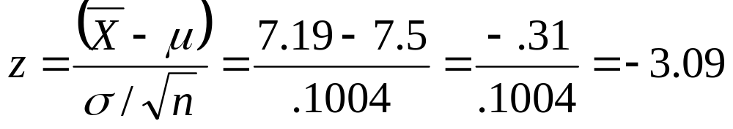
Enter the z-test
Calculating z test will tell us where the sample lies on the normal distribution of population means.
This tell us that our class mean lies 3.09 deviation units below the population mean.

Slide 11
Z-scores and Z-tests
I'm so confused? Z-scores, z-tests, what z hell is going on here?
The z-score is a z-test for a single number. Just as the z-score tells how far an individual score is from the sample mean, the z-test tells us how far a sample mean is from the population mean.

Slide 12
The Language of Hypothesis Testing: Stating the null hypothesis
In the language of hypothesis testing, we always start by assuming no effect or no difference. The null (meaning nothing, nil, zippo) hypothesis for the comparison of our class sleep time to the mean sleep time of all St. Mary's students is:
H₀: There is no difference between the sleep time of class PY620C and the St. Mary University student population.

Slide 13
The Language of Hypothesis Testing: Stating the alternative hypothesis
H₁: There is a difference between the sleep time of class PY620C and the St. Mary University student population.
Strictly speaking there MUST be a difference between the mean sleep time of students in PY620C and the mean sleep time of St. Mary's students overall. It might be very tiny but there will be a difference.
The question really is, how unlikely does it have to be that there is no difference before you say that there is.

Slide 14

The null hypothesis is a very specific statement about a parameter of the population(s). It is labeled H₀.
The alternative hypothesis is a more general statement about a parameter of the population(s) that is exclusive of the null hypothesis. It is labeled H_{a}.
  Weight of cherry tomato packs:
  H₀ : µ = 227 g (µ is the average weight of the population of packs)
  H_{a} : µ ≠ 227 g (µ is either larger or smaller)

Slide 15
One Tailed and Two Tailed Tests
A one-tailed test specifies the direction of the difference in advance.
A two-tailed test is a test of any difference between groups, regardless of the direction of the difference.
We usually use two-tailed tests unless a difference is only possible in one direction. We do this because if we posit that a difference is in one direction and it winds up being in the other direction, we have a dilemma. In essence we have evidence but it is inadmissible.

Slide 16
How to choose?
What determines the choice of a one-sided versus a two-sided test is what we know about the problem before we perform a test of statistical significance.
  A health advocacy group tests whether the mean nicotine content of a brand of cigarettes is greater than the advertised value of 1.4 mg.
  Here, the health advocacy group suspects that cigarette manufacturers sell cigarettes with a nicotine content higher than what they advertise in order to better addict consumers to their products and maintain revenues.
  Thus, this is a one-sided test: H₀ : µ = 1.4 mg H_{a} : µ > 1.4 mg
It is important to make that choice before performing the test or else you could make a choice of “convenience” or fall in circular logic.

Slide 17
The Rationale of Null Hypothesis Testing
In Null Hypothesis in Significance Testing (NHST) we make a bet. It could be that the difference in heights is simply by chance. This is the bet: If , given the SD and N for the sample, the difference observed can occur more than 5 times out of 100, we can't reject the null hypothesis, we can't conclude the difference is anything more than chance. If, on the other hand, the difference observed is unlikely to be observed more than 5 times out of 100, than we can reject the null hypothesis and say that the class is different from the overall school in height.

Slide 18
What does rejecting the Null hypothesis tell us?
Does it tell us how big the difference was? NO.
Does it tell us how rare the sample mean would be in the population if there was no difference? Strictly speaking NO. The probability level that we choose is a decision rule. We either make the cut or we don't.
We decide ahead of time what risk we will take in saying that something is different when in fact it is not.

Slide 19
More NHST stuff
If our rule is that we will reject the null hypothesis if the probability of the observed sample is less than 5 in 100 (p<.05) than the following is true:
P=.049999 reject the null.
P=.000001 reject the null.
P=.050001 fail to reject the null.
P=.99999 fail to reject the null.

Slide 20
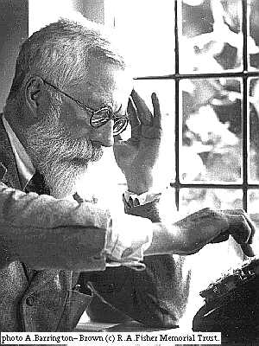
It's Fisher's fault (sort of)
Who the hell came up with this crazy way of thinking?
Sir Ronald Fisher. The father of modern statistics.

Slide 21
What was Fisher thinking?
Fisher came out of agronomy and was looking for a yes/no decision rule based on probability. Did this plant strain grow better than that plant strain? Was this manure better than that manure? (in science lingo we sometimes say " Those data aren't worth manure !"– or something like that- it’s really just a tribute to Fisher.)

Slide 22
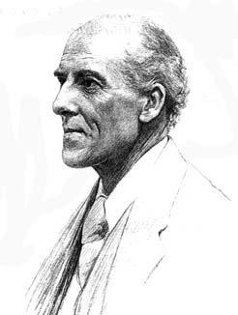
Fisher vs. Pearson
Karl Pearson was also one of the towering figures of modern statistics. Pearson felt that , instead of rejecting the null, we should choose between two alternative hypotheses.
These guys (both Sirs) did not get along at all. In fact, Pearson (who founded Biometrika, wouldn't publish Fisher's papers. Fisher, turned down a prestigious position because he would have had to work for Pearson.
Vs.

Slide 23
Interpreting a P-value
Could random variation alone account for the difference between the null hypothesis and observations from a random sample?
  A small P-value implies that random variation because of the sampling process alone is not likely to account for the observed difference.
  With a small p-value we reject H₀. The true property of the population is significantly different from what was stated in H₀.
Thus, small P-values are strong evidence AGAINST H₀.
But how small is small…?

Slide 24
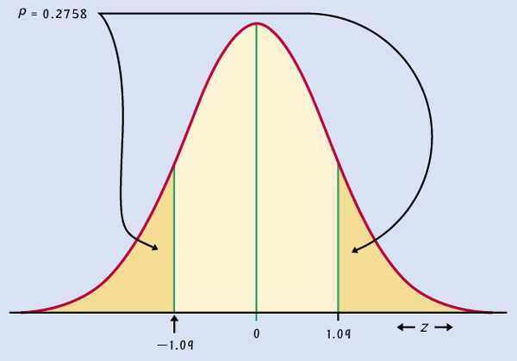
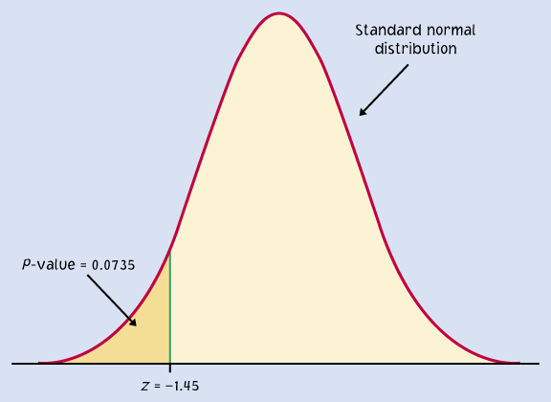
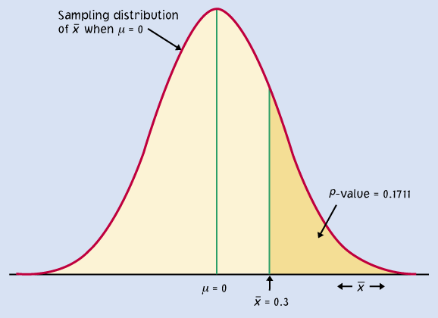
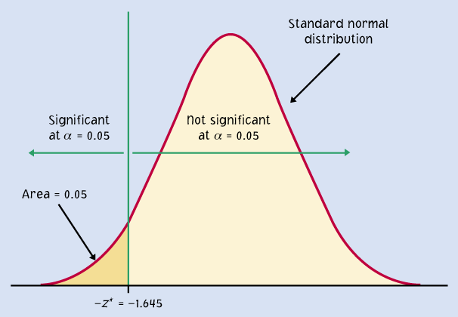
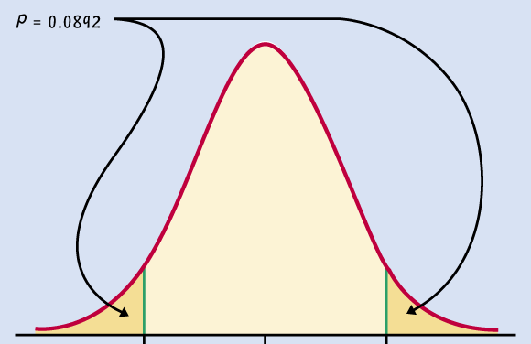
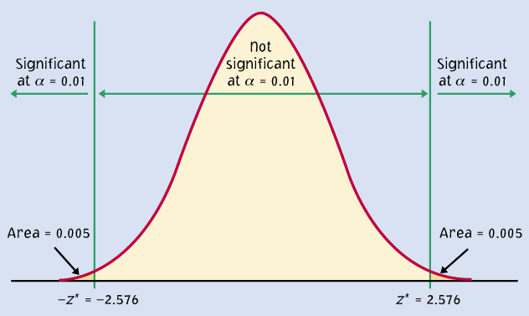
P = 0.2758
P = 0.0735
Significant P-value
???
P = 0.1711
P = 0.05
P = 0.0892
P = 0.01
When the shaded area becomes very small, the probability of drawing such a sample at random gets very slim. Oftentimes, a P-value of 0.05 or less is considered significant: The phenomenon observed is unlikely to be entirely due to chance event from the random sampling.

Slide 25
Where did p<.05 come from?
Apparently Fisher once said, while taking tea, that " If the probability of such an event were sufficiently small – say, 1 chance in 20- than one might regard the result as significant."
In other words, it is somewhat arbitrary.
Rosnow and Rosenthal have famously said " Surely God loves the .06 nearly as much as the .05".

Slide 26
The Signal to Noise Ratio
The z-test that we performed and all other statistical tests are signal to noise ratios.
The signal is the observed difference between groups.
The noise is the variability in measures between individuals within each group.
It's like trying to listen to a conversation in a restaurant. If the background noise is too great, we can't distinguish the conversation from the noise that surrounds it.

Slide 27
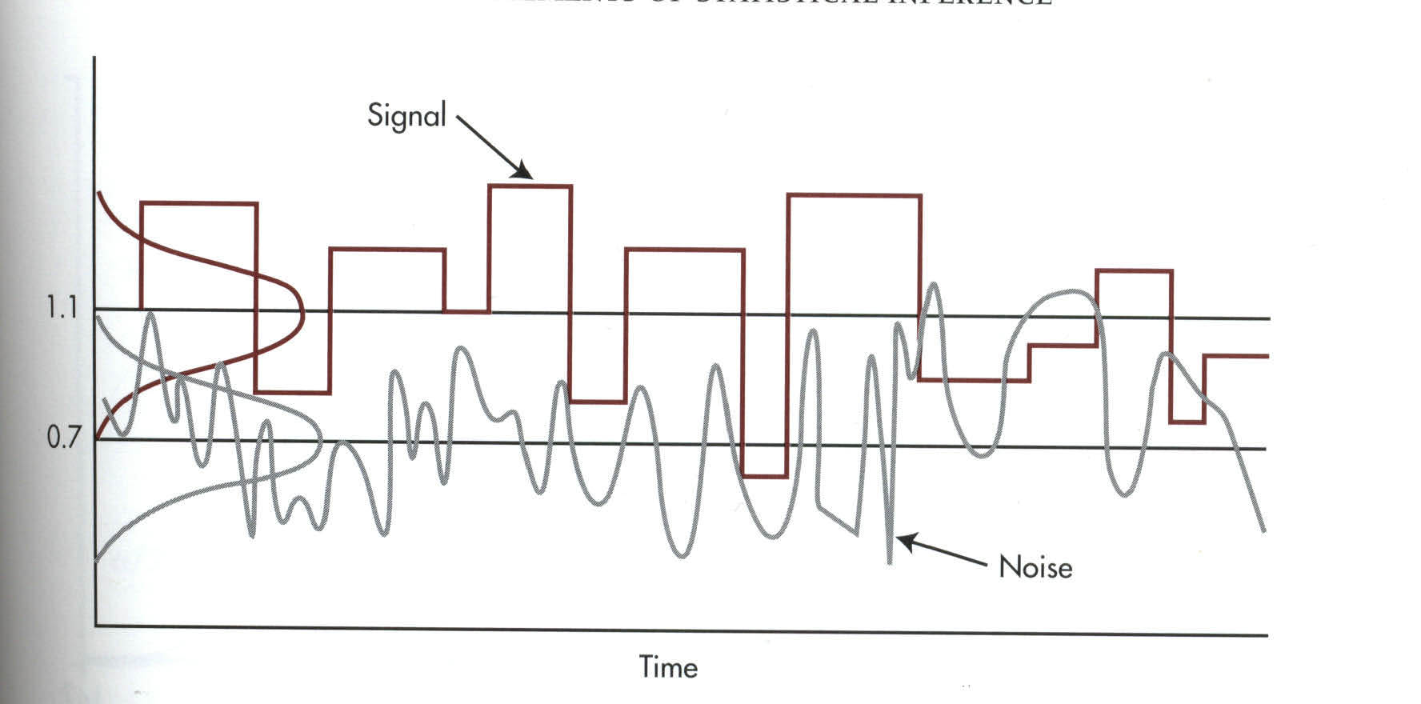
Signal to Noise

Slide 28
Four outcomes of a decision
There was a difference (signal) when there wasn't one.
There was a difference (signal) when there really was one.
There was no difference (signal) when there really was one.
There was no difference (signal) when there really wasn't one.

Slide 29
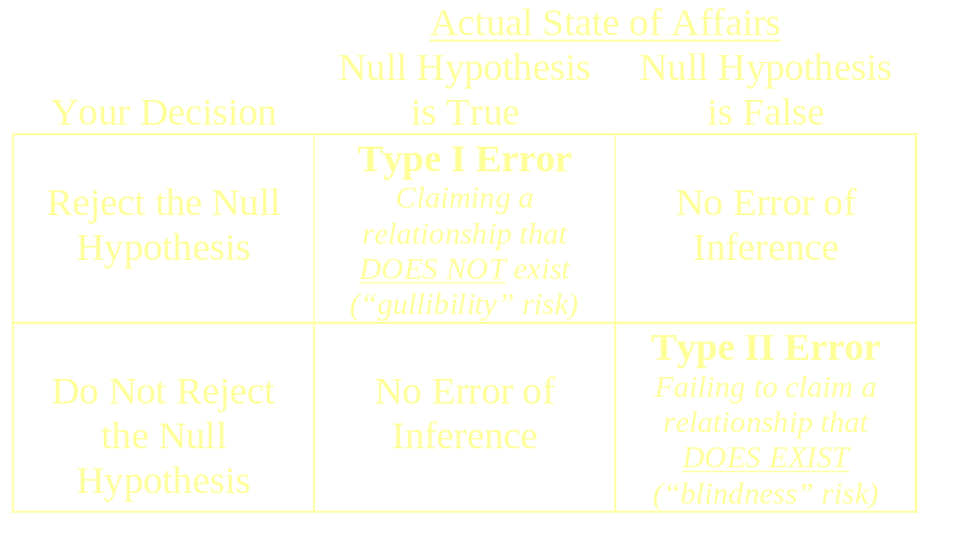
Possible Decision Outcomes in Hypothesis Testing

Slide 30
Type I and II errors
A Type I error is made when we reject the null hypothesis and the null hypothesis is actually true (incorrectly reject a true H₀).
The probability of making a Type I error is the significance level α
A Type II error is made when we fail to reject the null hypothesis and the null hypothesis is false (incorrectly keep a false H₀).
The probability of making a Type II error is labeled β.
The power of a test is 1 − β.

Slide 31
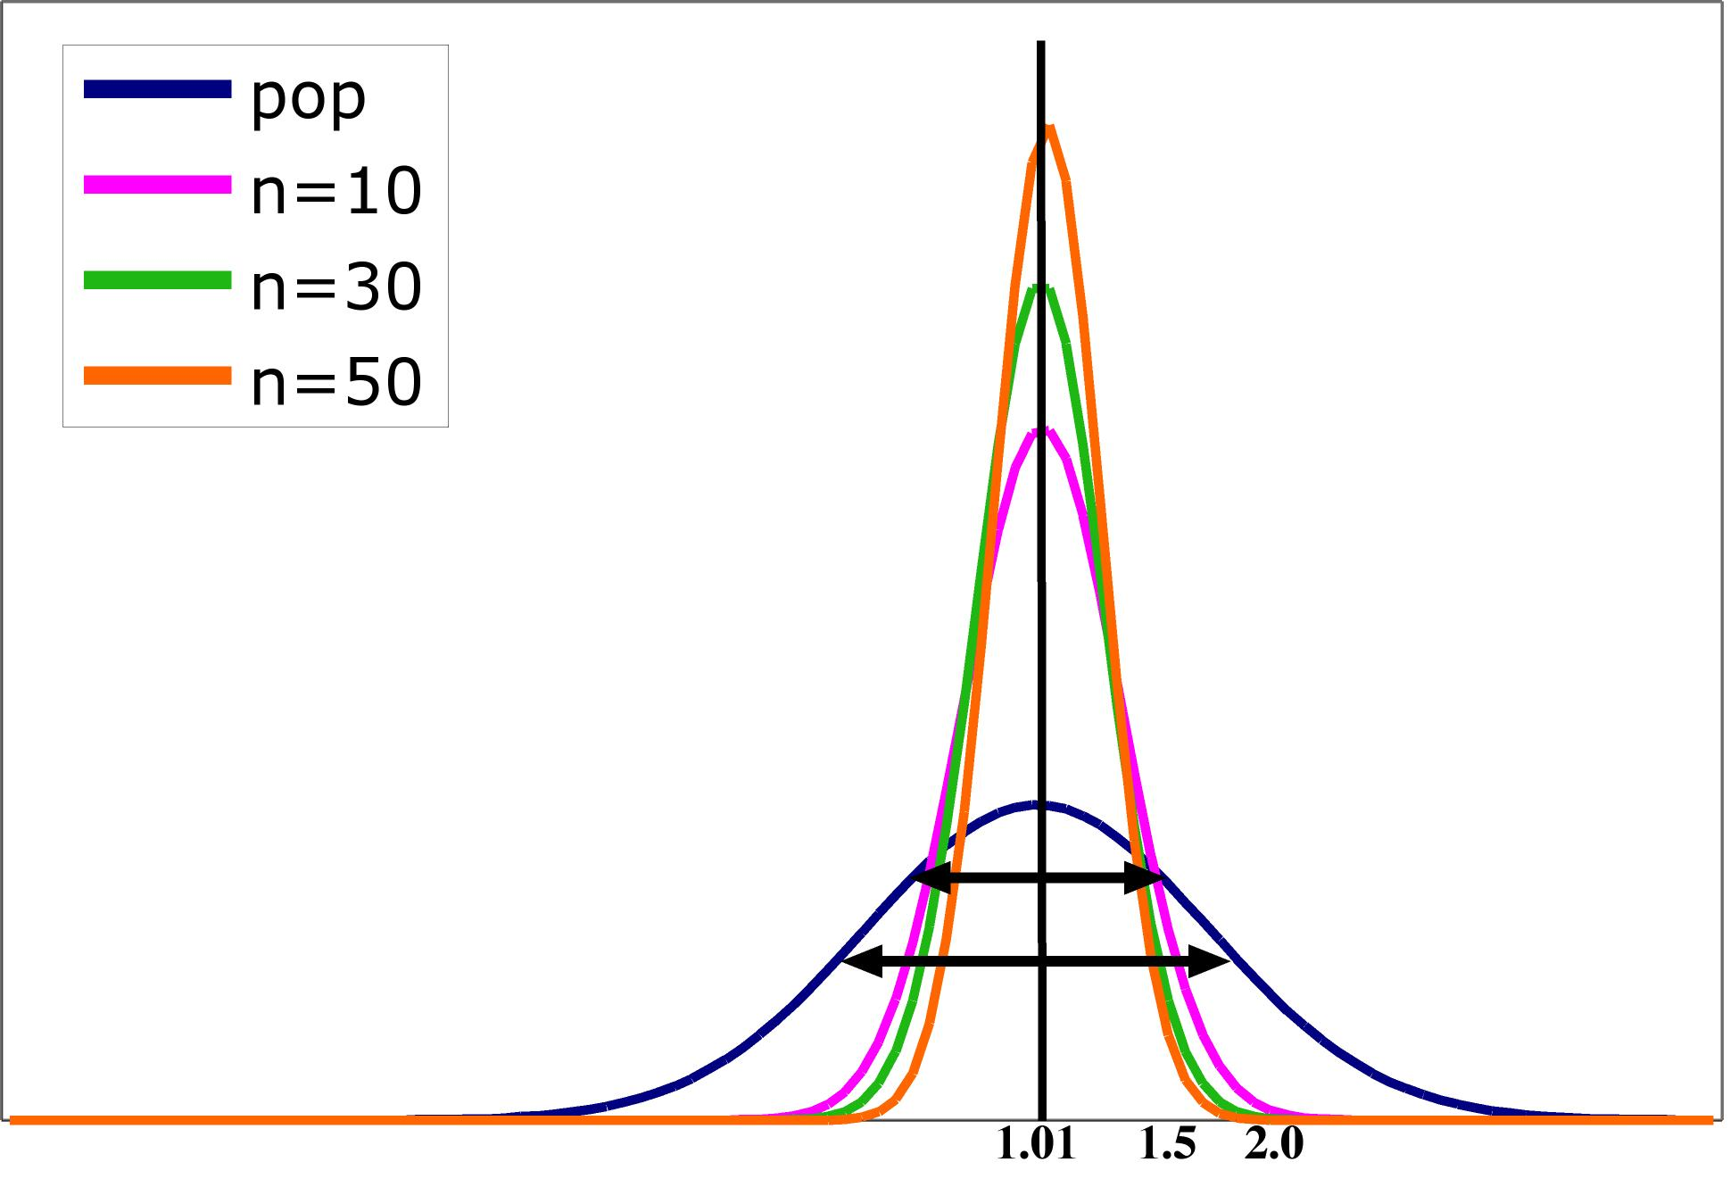
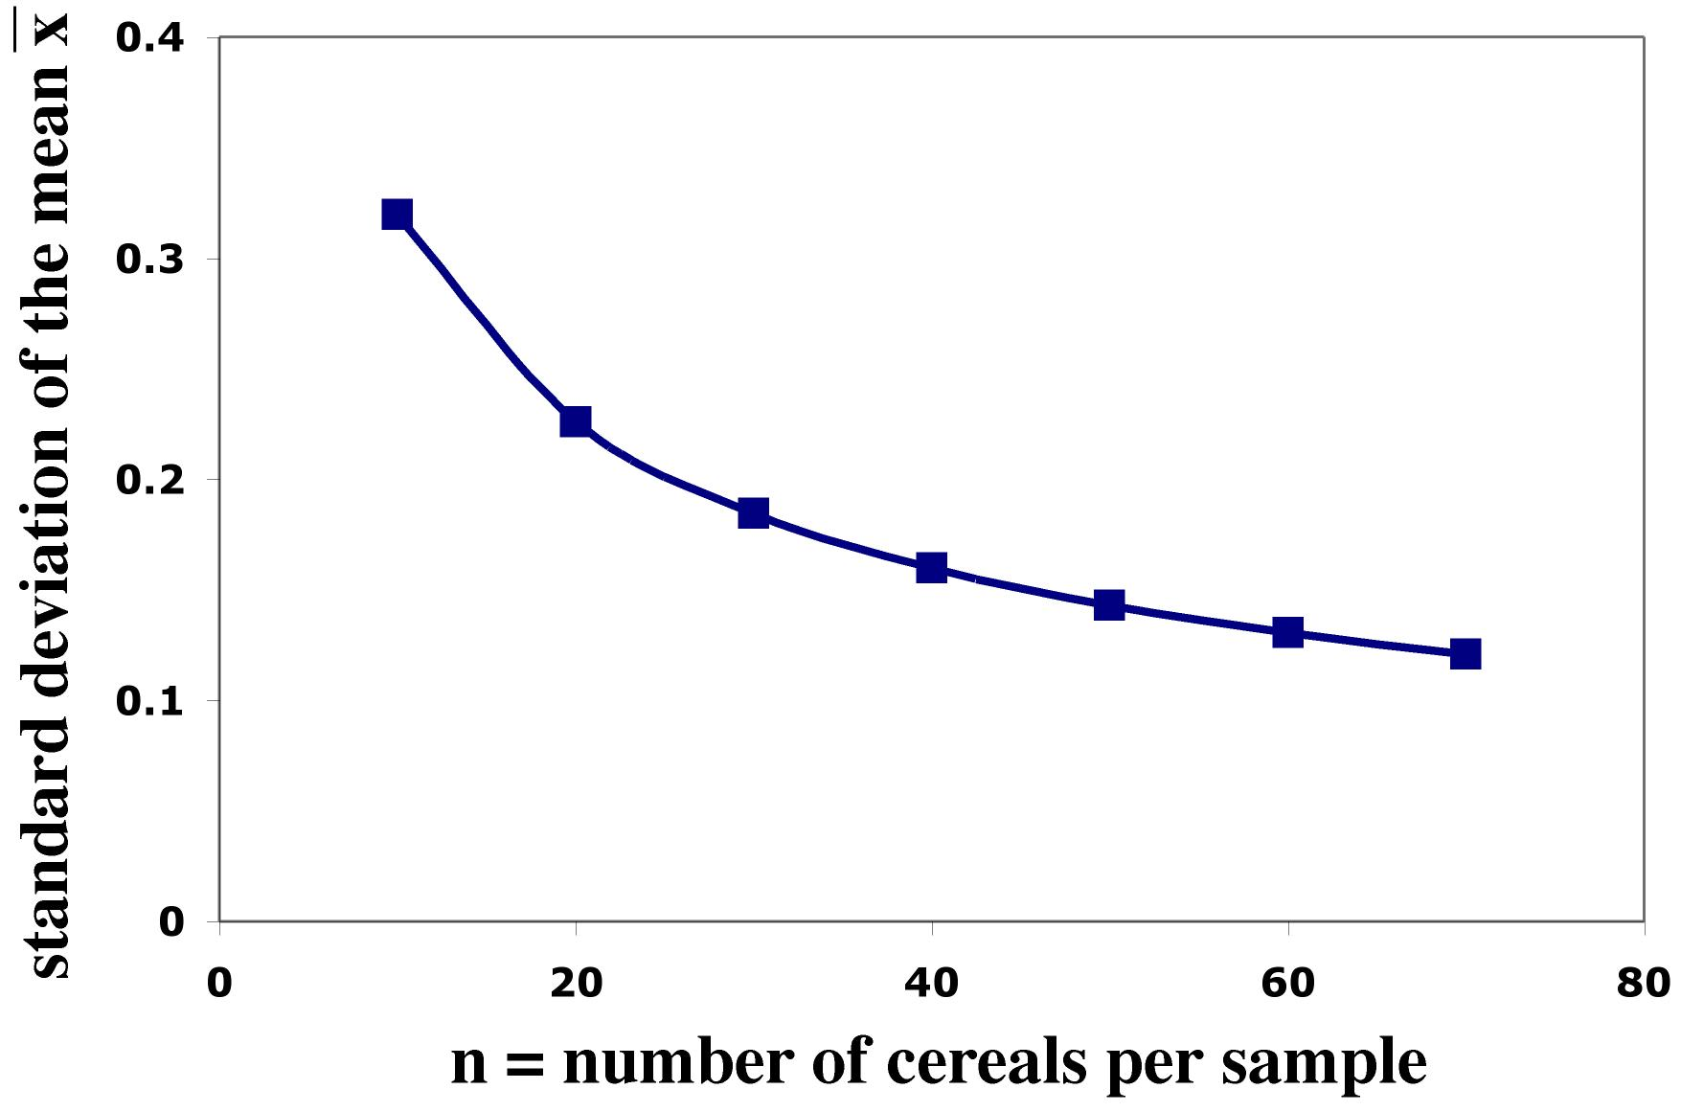
Impact of sample size
The spread in the sampling distribution of the mean is a function of the number of individuals per sample.
  The larger the sample size, the smaller
  the standard deviation (spread) of the
  sample mean distribution.
  But the spread only decreases at a rate
  equal to √n.
Standard error σ ⁄ √n
Sample size n

Slide 32
Type I error and sample size: comparing two means.
Group Size (n per group) | Significance level (likelihood of Type I error) | Difference between means | Likelihood of Type II error
37 | .2 | .5 SD | 20%
64 | .05 | .5 SD | 20%
100 | .008 | .5 SD | 20%

Slide 33
Type II error and sample size: comparing two means.
Group Size (n per group) | Significance level (likelihood of Type I error) | Difference between means | Likelihood of Type II error
30 | .05 | .5 SD | 53%
64 | .05 | .5 SD | 20%
100 | .05 | .5 SD | 6%

Slide 34
Power
Power is the probability of concluding that there was a difference, when, in fact, there really was one (power=1-β).
If probability of Type II error is 20%, power =80% (1-.2=.8).

Slide 35
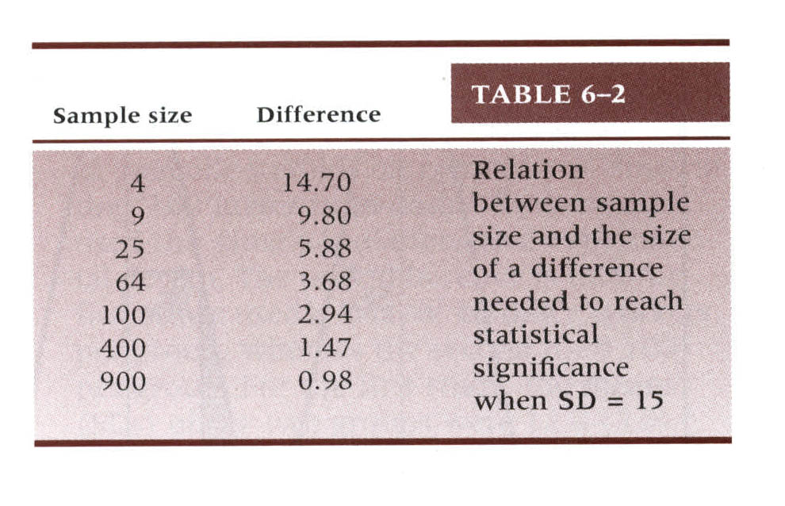
Effect Size
The effect size is a measure of the size of the difference between two samples or the degree of association between two variables.

Slide 36
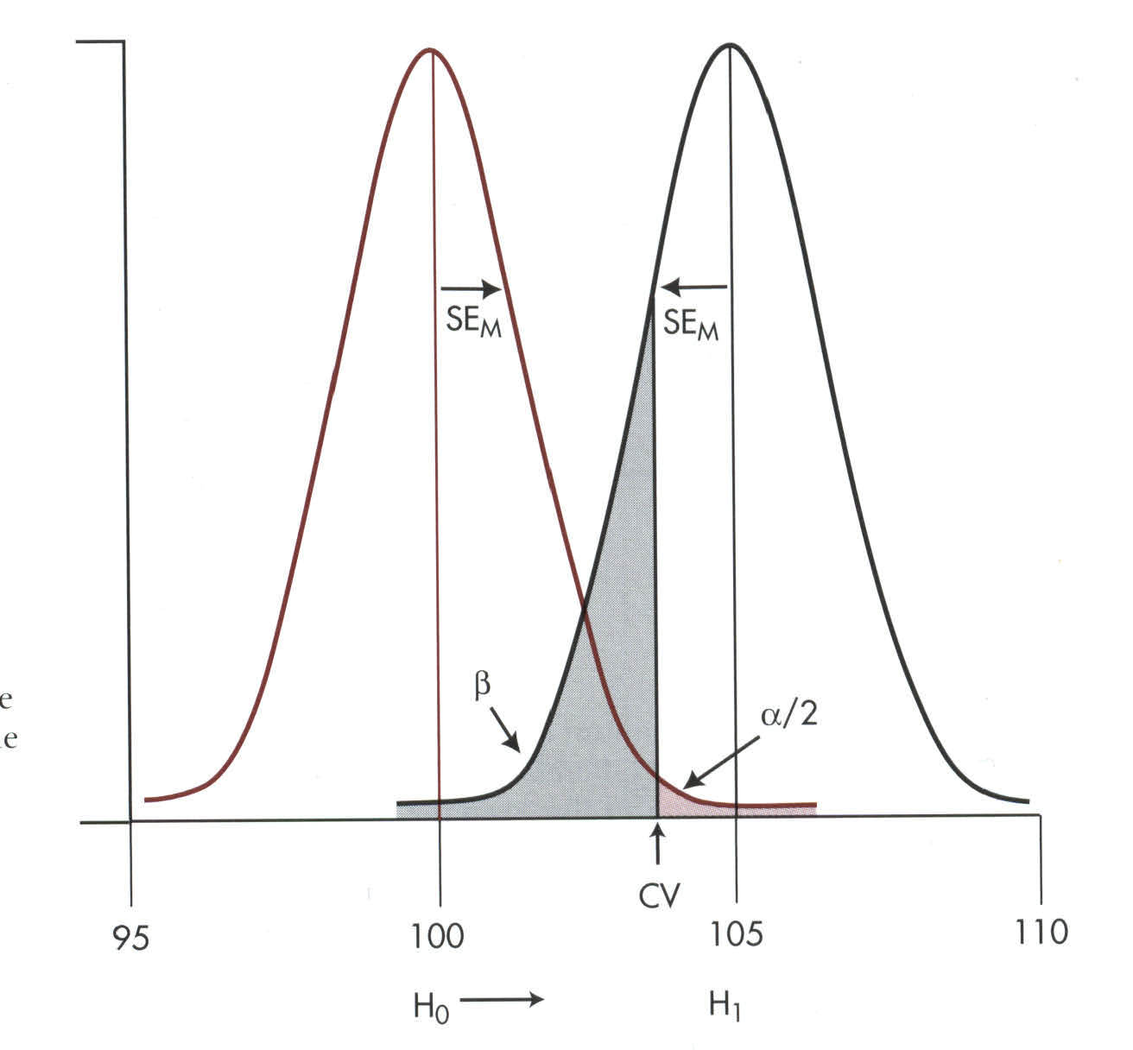
Putting it all together
Type I error, Type II error, sample size, and effect size are all tied together.

Slide 37
Decreasing Error
How can we decrease the likelihood of making a Type I (saying it was different when it wasn't) or Type II error (saying it wasn't different when it was)?
Increase sample size (decreases SE)
Increase effect size (a bigger difference requires less precision).

Slide 38
Confidence Intervals
Confidence intervals are the area around a sample mean that we are sure that the true “population” mean lies- within a certain probability.
95%CI=Sample Mean +1.96*SE
The 95% confidence interval around the class mean sleep time is 7.19 + 1.96(.1004)=7.19 + .197 or 6.93 to 7.39.

Slide 39
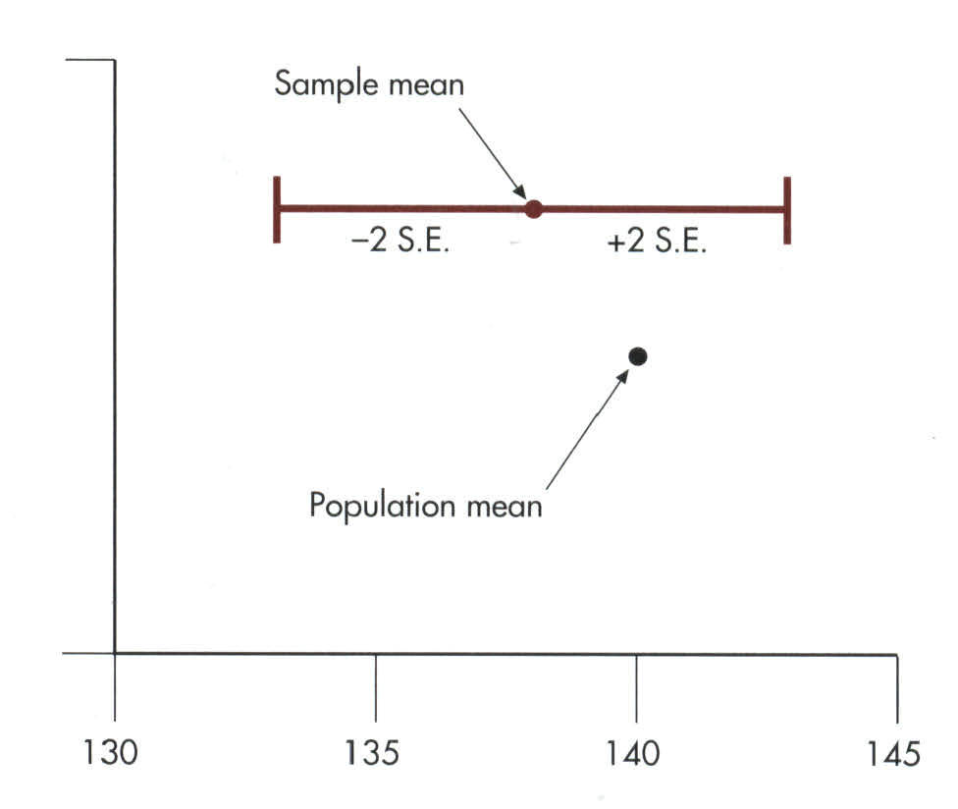
Confidence Interval
The 95% confidence interval states that 95 times out of 100 the true mean lies within this range.

Slide 40
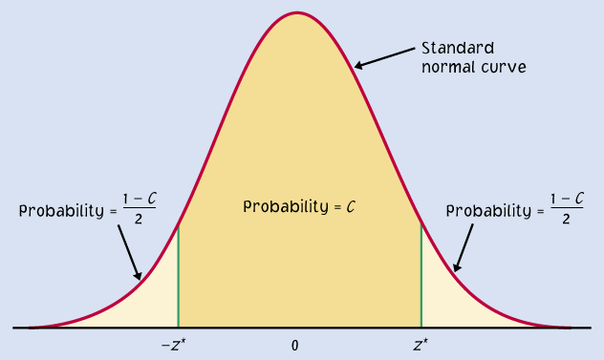
Confidence intervals to test hypotheses
Because a two-sided test is symmetrical, you can also use a confidence interval to test a two-sided hypothesis.
In a two-sided test,
C = 1 – α.
C =confidence level
α =significance level
α /2
α /2
Packs of cherry tomatoes (σ = 5 g): H₀ : µ = 227 g versus H_{a} : µ ≠ 227 g
Sample average 222 g. 95% CI for µ = 222 ± 1.96*5/√4 = 222 g ± 4.9 g
227 g does not belong to the 95% CI (217.1 to 226.9 g). Thus, we reject H₀.

Slide 41
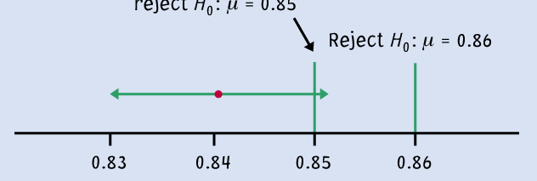

Logic of confidence interval test
Ex: Your sample gives a 99% confidence interval of .
With 99% confidence, could samples be from populations with µ = 0.86? µ = 0.85?
Cannot reject
H₀: μ = 0.85
Reject H₀ : μ = 0.86
99% C.I.
A confidence interval gives a black and white answer: Reject or don't reject H₀. But it also estimates a range of likely values for the true population mean µ.
A P-value quantifies how strong the evidence is against the H₀. But if you reject H₀, it doesn’t provide any information about the true population mean µ.

Slide 42
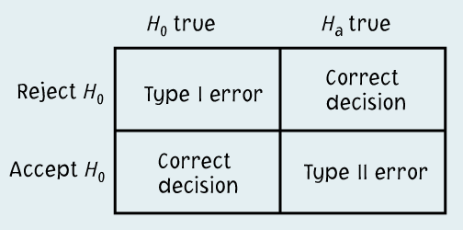
Running a test of significance is a balancing act between the chance α of making a Type I error and the chance β of making a Type II error. Reducing α reduces the power of a test and thus increases β.
It might be tempting to emphasize greater power (the more the better).
  However, with “too much power” trivial effects become highly significant.
  A type II error is not definitive since a failure to reject the null hypothesis does not imply that the null hypothesis is wrong.

